Slide 1
Capstone Engagement
Assessment, Analysis, and Hardening of a Vulnerable System
Prepared By: Rebecca La Plant, May 14th, 2021

Slide 2
Table of Contents
This document contains the following sections:
01
Network Topology
02
Red Team: Security Assessment
03
Blue Team: Log Analysis and Attack Characterization
Hardening: Proposed Alarms and Mitigation Strategies
04

Slide 3
Network Topology
3

Slide 4
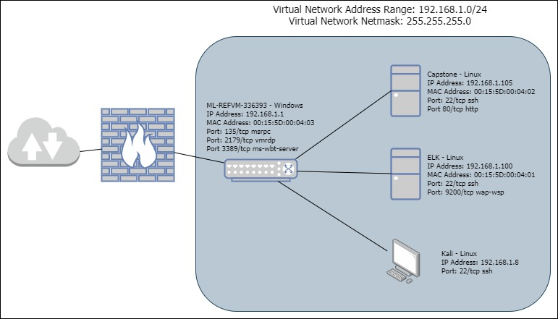
Network Topology
Network
Address Range: 192.168.1.0/24
Netmask: 255.255.255.0
Gateway: 192.168.1.1
Machines
IPv4: 192.168.1.1
OS: Microsoft
Hostname: ML-REFVM-336393
IPv4: 192.168.1.100
OS: Linux
Hostname: ELK
IPv4: 192.168.1.105
OS: Linux
Hostname: Capstone
IPv4: 192.168.1.8
OS: Linux
Hostname: Kali

Slide 5
Red Team
Security Assessment
5

Slide 6
Recon: Describing the Target
Nmap identified the following hosts on the network:
Hostname | IP Address | Role on Network
ML-REFVM-33639 | 192.168.1.1 | Switch/Gateway
Kali | 192.168.1.8 | Attack Computer
ELK | 192.168.1.100 | Network Monitor with
Capstone | 192.168.1.105 | Apache Web Server -Target Machine
Notes:
Network
Address Range: 192.168.1.0/24
Netmask: 255.255.255.0
Gateway: 192.168.1.1
Machines
IPv4: 192.168.1.1
OS: Microsoft
Hostname: ML-REFVM-336393
IPv4: 192.168.1.100
OS: Linux
Hostname: ELK
IPv4: 192.168.1.105
OS: Linux
Hostname: Capstone
IPv4: 192.168.1.8
OS: Linux
Hostname: Kali

Slide 7
Vulnerability Assessment
The assessment uncovered the following critical vulnerabilities in the target:
Vulnerability | Description | Impact
Sensitive Data Exposure | The sensitive data (/company_folders/sercret_folder and the /webdav were available to the public and accessible through a web browser | The public facing information revealed that ‘Ashton’ was the admin for the secret_folder
Security Misconfiguration | The servers had no alerts or limits for failed log on attempts – this allowed for easy access with a Brute-Force password exploit | Using the sensitive data we found on the public facing web page we were able to Brute-Force attack the login credentials to the /secret_folder. Inside that folder there was a password hash for ‘Ryan’ and instructions on how to upload a /webdav folder
Unrestricted File Upload | No restrictions for file uploads to the /webdav folder | We uploaded a reverse tcp script (shell.php) which allowed backdoor access and complete C2 of the Capstone web server

Slide 8
Exploitation: Sensitive Data Exposure
01
02
Tools & Processes
NMAP scan revealed IP address 192.168.1.105 had an open HTTP port 80.
Utilized Firefox web browser to locate and access company folders.
Achievements
Noted company file structure
Accessed the /company_folders/secret_folders and /meet_our_team folders
Determined that Ashton was the admin of the /company_folders/secret_folder

Slide 9
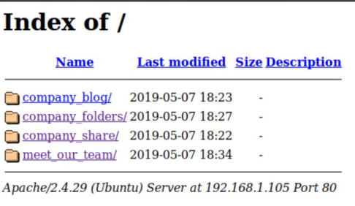
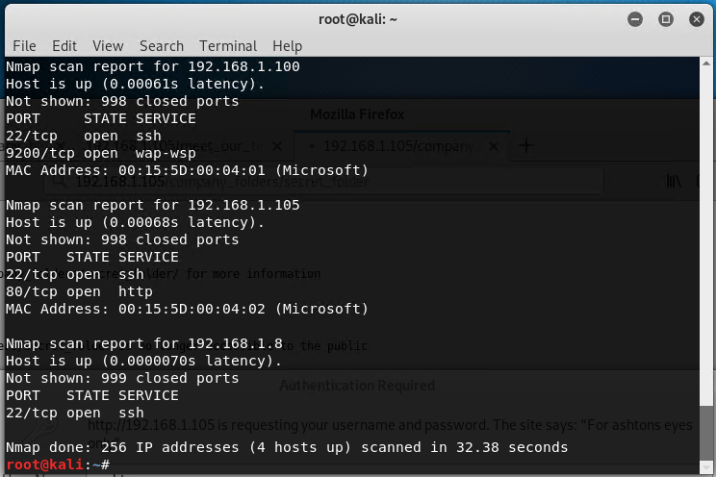
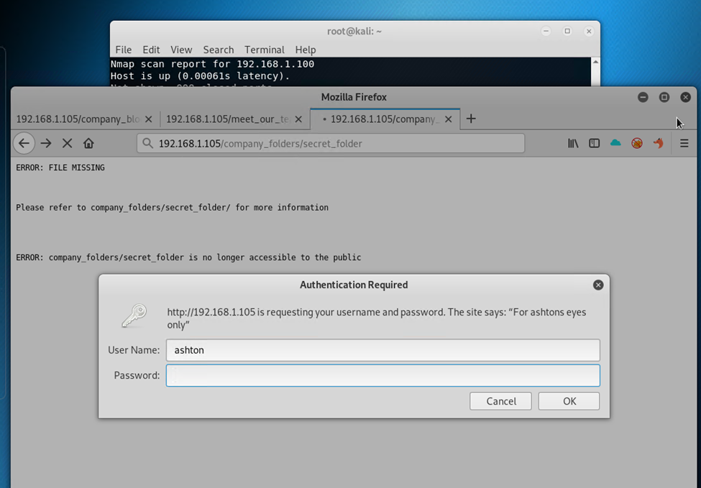
Exploitation: Sensitive Data Exposure
03

Slide 10
Exploitation: Security Misconfiguration
01
02
Tools & Processes
A tool called Hydra on the Kali box was used to Brute-Force the password to the /company_folders/secret_folder utilizing Ashton as the user
Utilized online reverse-hash look up to find Ryan’s password
Achievements
Hydra tool Brute-Forced Ashton’s password (leopoldo)
Access to /secret_folder granted
Inside /secret_folder the instructions to download the /webdav folder were located
Ryan’s password hash was located
Access granted to /webdav

Slide 11
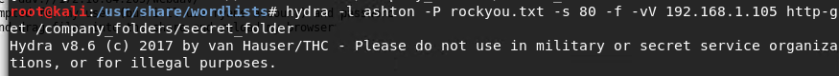
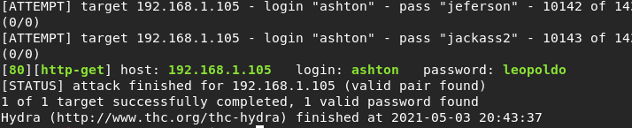
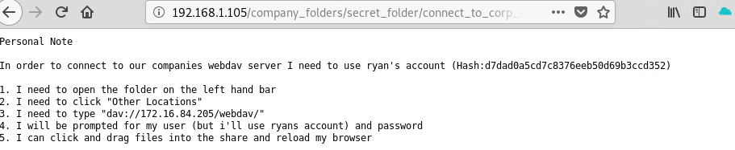
Exploitation: Security Misconfiguration
03

Slide 12
Exploitation: Unrestricted File Upload
01
02
Tools & Processes
Utilized msfvenom to write a shell.php to create a reverse tcp connection with meterpreter.
The shell.php file was uploaded to the server via the /webdav folder and executed.
Achievements
Created a backdoor and accessed the server utilizing Metasploit meterpreter and the reverse tcp shell.php we created and executed
C2 of the target machine was achieved and we captured the flag.txt file.

Slide 13
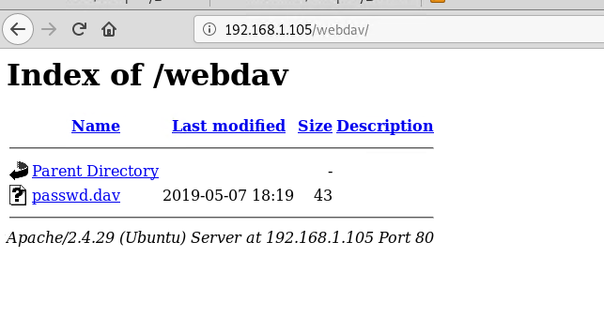
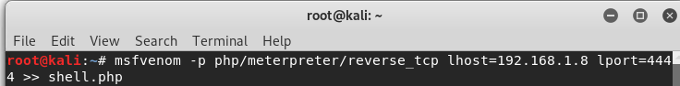
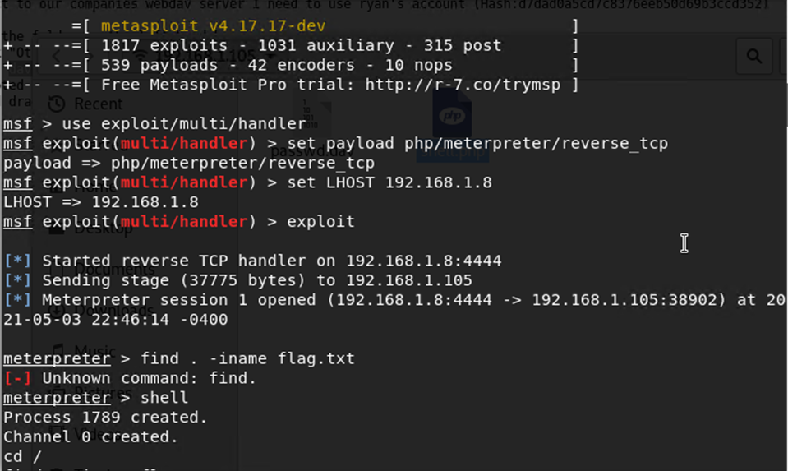
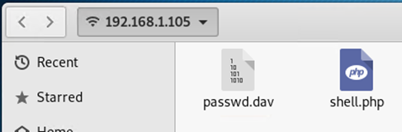
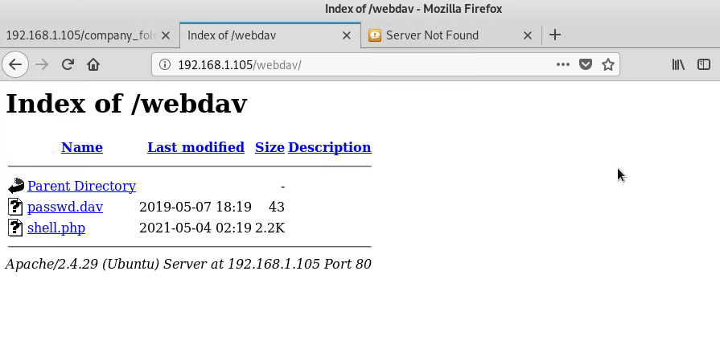
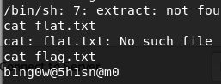
Exploitation: Unrestricted File Upload
03

Slide 14
Blue Team
Log Analysis and Attack Characterization
14

Slide 15
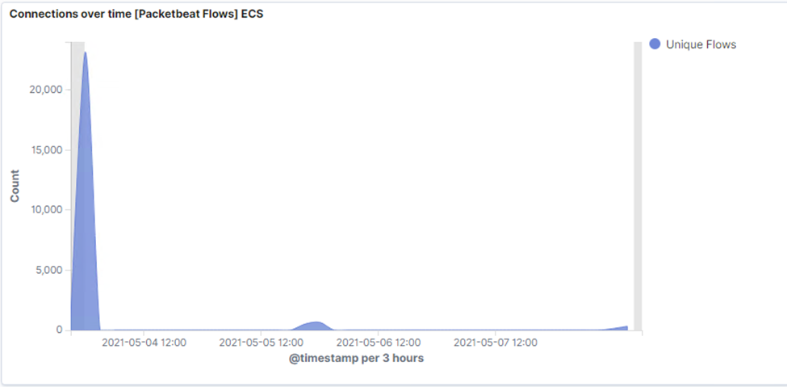
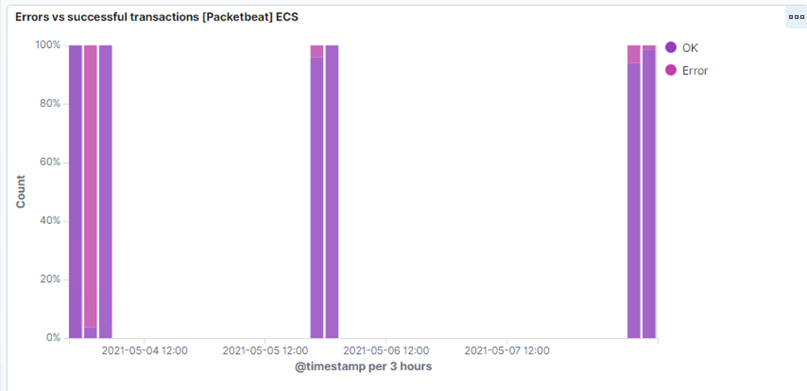

Analysis: Identifying the Port Scan
Port scan started May 3rd at 11pm
20,045 packets were sent from IP address 192.168.1.8 to 192.168.1.105
Huge traffic spike over time compared to normal operations, with almost all of them being errors or 401 codes.
Notes:
Started May 3rd @ 23:00
192.168.1.8 to 192.168.1.105.

Slide 16
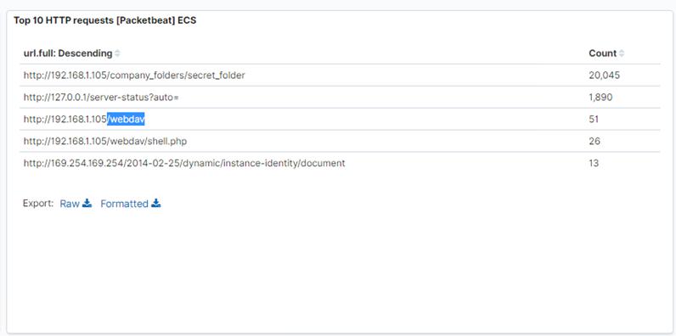
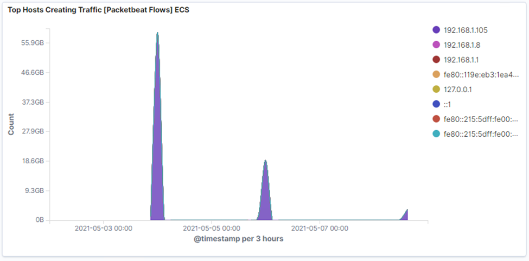
Analysis: Finding the Request for the Hidden Directory
Requests started May 4th about midnight and there were 20,045 requests made
The requested files were access to the /secret_folder and its contents (information on how to access the /webdav and Ryan’s password hash)
Notes:
20045 from May 4th 2021 @ 0000 to 01:39 - from 192.168.1.8

Slide 17
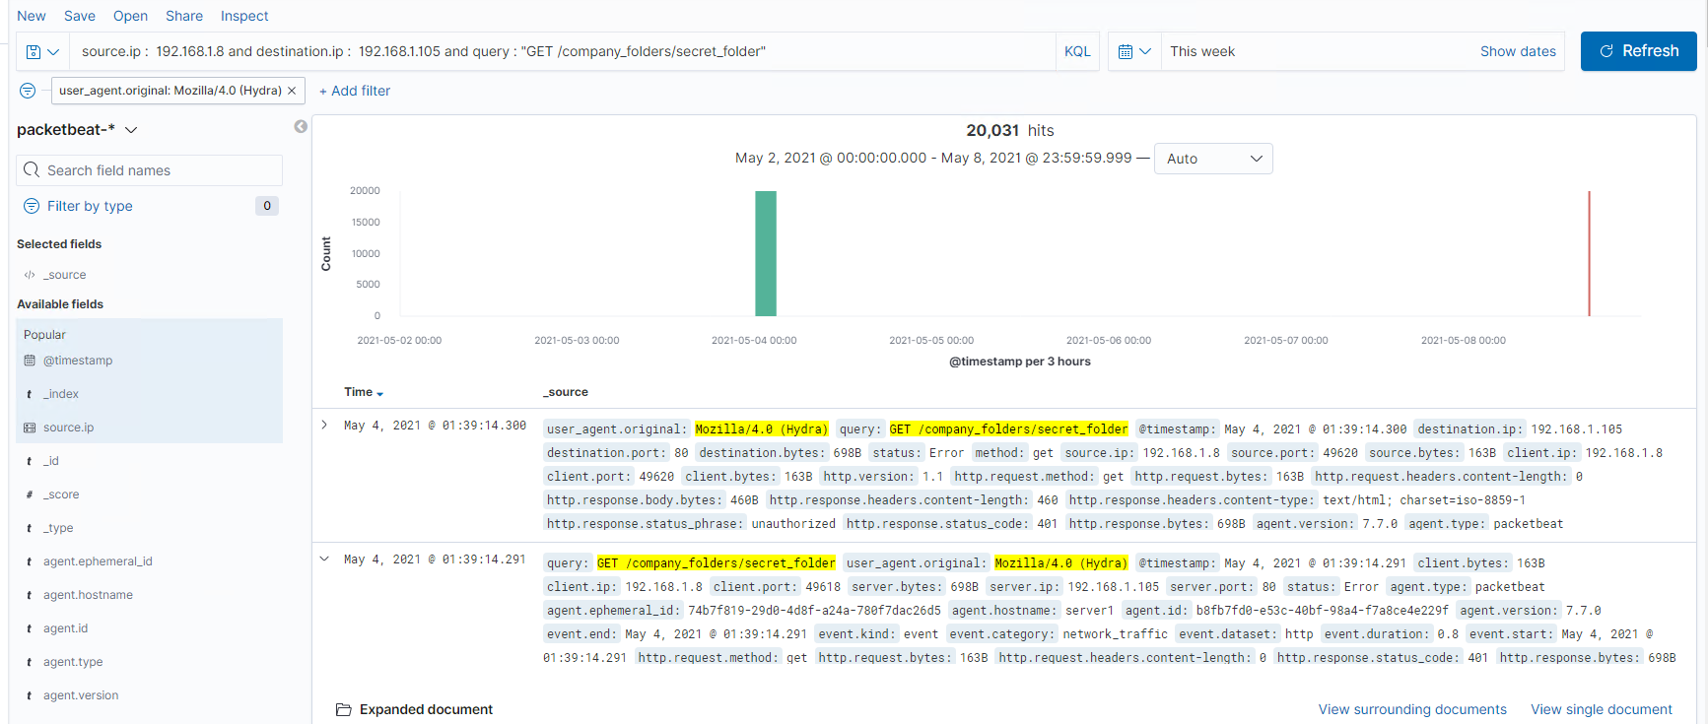
Analysis: Uncovering the Brute Force Attack
There were 20,031 requests made by Hydra (the password cracking software) to the /secret_folder
There were two successful interactions from the Hydra software and the /secret_folder. 20,029 unsuccessful attempts were made prior to successful interations.

Slide 18

Analysis: Finding the WebDAV Connection
There were 51 requests to the /webdav directory.
Once inside the /webdav directory the shell.php was requested 26 times.

Slide 19
Blue Team
Proposed Alarms and Mitigation Strategies
19

Slide 20
Mitigation: Blocking the Port Scan
Alarms
System Hardening
What kind of alarm can be set to detect future port scans?
Set an alarm to trigger if any IP address is scanned that is not the web server and the destination ports that are not HTTP related (80, 443)
What threshold would you set to activate this alarm?
Set the alarm to log activity and send out an email when non-HTTP ports are requested more than 5 times in an hour.
What configurations can be set on the host to mitigate port scans?
The firewall needs to have rules that block all incoming and outgoing traffic except for over ports 80 and 443.
Describe the solution. If possible, provide required command lines.
Reconfigure the firewall to block all incoming and outgoing traffic from non-essential ports and investigate each internal IP and what should/shouldn’t be allowed to interact over which ports.
Notes:
What configurations can be set on the host to mitigate port scans?
Describe the solution. If possible, provide required command lines.

Slide 21
Mitigation: Finding the Request for the Hidden Directory
Alarms
System Hardening
What kind of alarm can be set to detect future unauthorized access?
Set an alarm that will alert when any secret files or directories are accessed by non-whitelisted IP addresses.
What threshold would you set to activate this alarm?
Set the alarm to log and send and email anytime a directory or file marked secret has been accessed by and IP address that is not on the whitelist.
What configurations can be set on the host to block unwanted access?
System hygiene check, see if the files on the webserver need to be on the web server or can we move them to a more secure internal portion of the network.
Describe the solution. If possible, provide required command lines.
IP addresses can be white or blacklisted in /etc/httpd/conf/httpd.conf

Slide 22
Mitigation: Preventing Brute Force Attacks
Alarms
System Hardening
What kind of alarm can be set to detect future brute force attacks?
Set an alarm to alert anytime multiple failed logins happen in a short period of time. Also set an alarm against the Hydra user agent.
What threshold would you set to activate this alarm?
Email and log anytime there are 5 or more failed login attempts in 1 minute.
Email and log anytime the Hydra user agent attempts to login
What configurations can be set on the host to block brute force attacks?
Setting a strong password policy that requires password lengths and special characters will deter brute force attacks.
Also setting up multi-factor authentication would require users to provide another credential in addition to their password making access one layer more secure.

Slide 23
Mitigation: Detecting the WebDAV Connection
Alarms
System Hardening
What kind of alarm can be set to detect future access to this directory?
Set an alarm to alert anytime secret files and directories are accessed by non-whitelisted IP addresses.
What threshold would you set to activate this alarm?
Email and log anytime a directory or file marked secret has been access by an IP address outside of the whitelisted Ips.
What configurations can be set on the host to control access?
Same as the /secret-folder settings we can configure the white and blacklists in the /etc/httpd/conf/httpd/conf file.
Also check the network hygiene and see if those secret files need to be on the webserver or if we can place them somewhere more secure which in the network.

Slide 24
Mitigation: Identifying Reverse Shell Uploads
Alarms
System Hardening
What kind of alarm can be set to detect future file uploads?
Set an alarm to alert anytime web server files are altered by a non whitelisted IP address.
What threshold would you set to activate this alarm?
Email and log anytime web server files are altered by a non whitelisted IP address.
What configurations can be set on the host to block file uploads?
Same as the /secret-folder settings we can configure the white and blacklists in the /etc/httpd/conf/httpd/conf file.
Also check the network hygiene and see if those secret files need to be on the webserver or if we can place them somewhere more secure which in the network.

Slide 25


The End of the
Capstone Engagement
Assessment, Analysis, and Hardening of a Vulnerable System

